Slide 1
Graph Mining: Laws, Generators and Tools
Christos Faloutsos
CMU

Slide 2

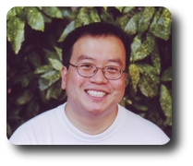
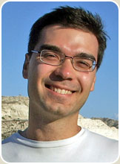
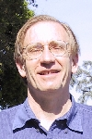
Thanks
Michael Mahoney
Lek-Heng Lim
Petros Drineas
Gunnar Carlsson

Slide 3
extras
disk accesses are expensive
hence: B-trees; R-trees; hash-joins
lately: hadoop map/reduce

Slide 4
Outline
Problem definition / Motivation
Static & dynamic laws; generators
Tools: CenterPiece graphs; Tensors
Other projects (Virus propagation, e-bay fraud detection)
Conclusions

Slide 5
Motivation
Data mining: ~ find patterns (rules, outliers)
Problem#1: How do real graphs look like?
Problem#2: How do they evolve?
Problem#3: How to generate realistic graphs
TOOLS
Problem#4: Who is the ‘master-mind’?
Problem#5: Track communities over time

Slide 6

Problem#1: Joint work with
Dr. Deepayan Chakrabarti
(CMU/Yahoo R.L.)

Slide 7
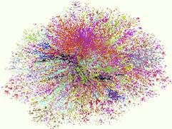
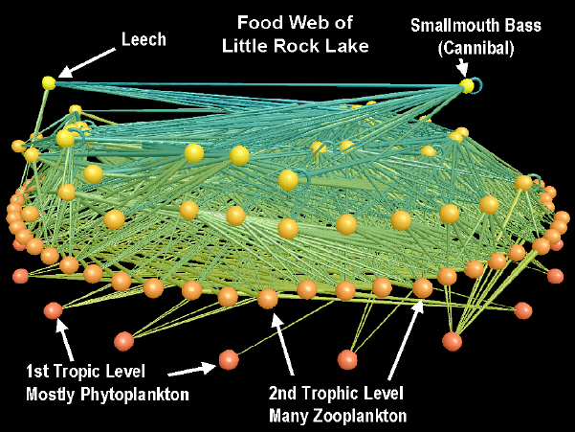
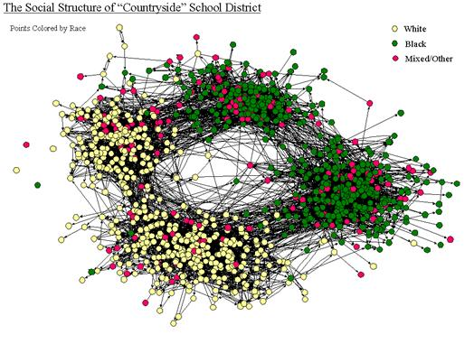
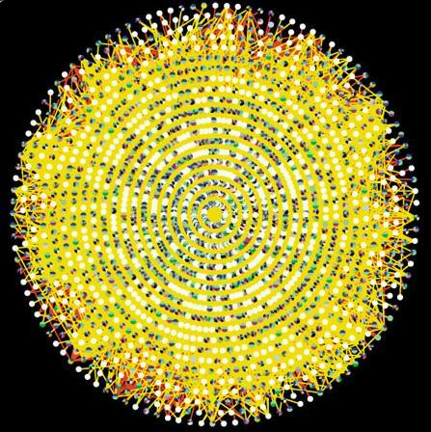
Graphs - why should we care?
Internet Map [lumeta.com]
Food Web [Martinez ’91]
Friendship Network [Moody ’01]
Protein Interactions [genomebiology.com]

Slide 8
Graphs - why should we care?
IR: bi-partite graphs (doc-terms)
web: hyper-text graph
... and more:
D₁
T₁
...
...
D_{N}
T_{M}

Slide 9
Graphs - why should we care?
network of companies & board-of-directors members
‘viral’ marketing
web-log (‘blog’) news propagation
computer network security: email/IP traffic and anomaly detection
....

Slide 10
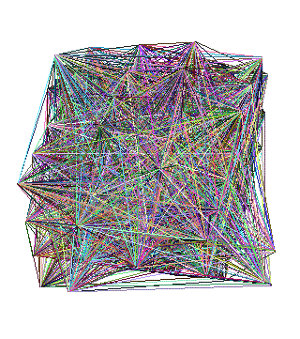
Problem #1 - network and graph mining
How does the Internet look like?
How does the web look like?
What is ‘normal’/‘abnormal’?
which patterns/laws hold?

Slide 11
Graph mining
Are real graphs random?

Slide 12
Laws and patterns
Are real graphs random?
A: NO!!
  Diameter
  in- and out- degree distributions
  other (surprising) patterns

Slide 13
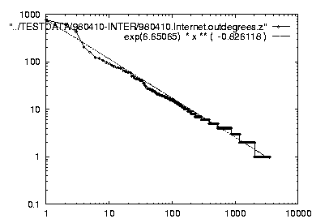
Solution#1
Power law in the degree distribution [SIGCOMM99]
internet domains
att.com
log(degree)
ibm.com
-0.82
log(rank)

Slide 14
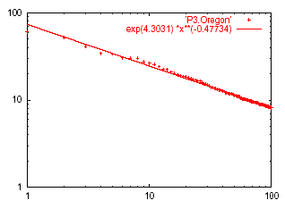
Solution#1’: Eigen Exponent E
Eigenvalue
Exponent = slope
E = -0.48
May 2001
Rank of decreasing eigenvalue
A2: power law in the eigenvalues of the adjacency matrix

Slide 15
Solution#1’: Eigen Exponent E
Eigenvalue
Exponent = slope
E = -0.48
May 2001
Rank of decreasing eigenvalue
[Papadimitriou, Mihail, ’02]: slope is ½ of rank exponent

Slide 16
But:
How about graphs from other domains?

Slide 17
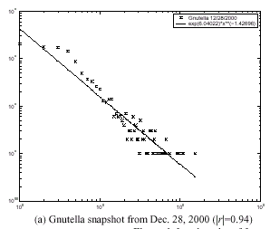
The Peer-to-Peer Topology
[Jovanovic+]
Count versus degree
Number of adjacent peers follows a power-law

Slide 18
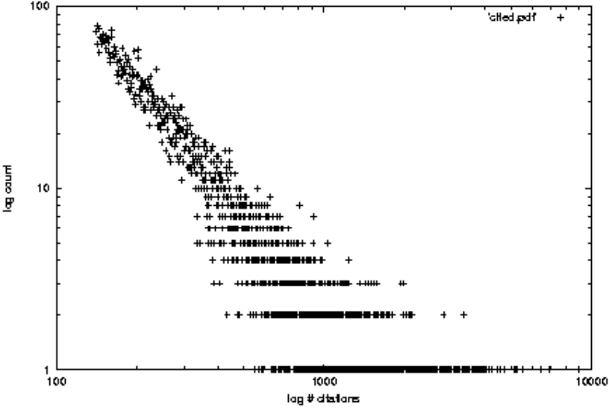
More power laws:
citation counts: (citeseer.nj.nec.com 6/2001)
log(count)
Ullman
log(#citations)

Slide 19
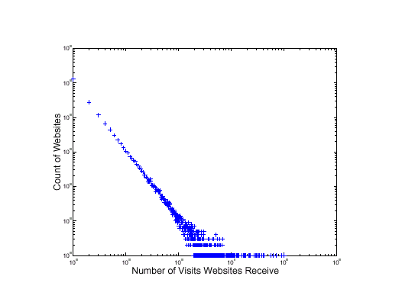
More power laws:
web hit counts [w/ A. Montgomery]
Web Site Traffic
log(count)
Zipf
``ebay’’
users
sites
log(in-degree)

Slide 20
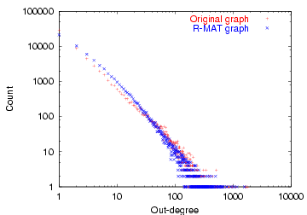
epinions.com
who-trusts-whom [Richardson + Domingos, KDD 2001]
count
trusts-2000-people user
(out) degree

Slide 21
Motivation
Data mining: ~ find patterns (rules, outliers)
Problem#1: How do real graphs look like?
Problem#2: How do they evolve?
Problem#3: How to generate realistic graphs
TOOLS
Problem#4: Who is the ‘master-mind’?
Problem#5: Track communities over time

Slide 22

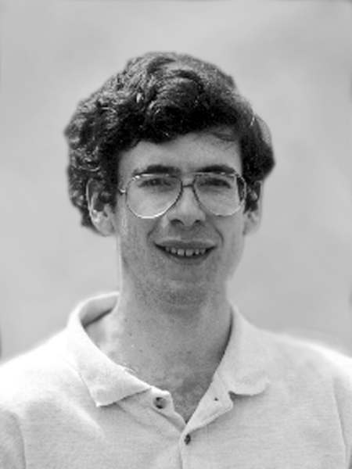
Problem#2: Time evolution
with Jure Leskovec (CMU/MLD)
and Jon Kleinberg (Cornell – sabb. @ CMU)

Slide 23
Evolution of the Diameter
Prior work on Power Law graphs hints at slowly growing diameter:
  diameter ~ O(log N)
  diameter ~ O(log log N)
What is happening in real data?
Notes:
Diameter first, DPL second
Check diameter formulas
As the network grows the distances between nodes slowly grow

Slide 24
Evolution of the Diameter
Prior work on Power Law graphs hints at slowly growing diameter:
  diameter ~ O(log N)
  diameter ~ O(log log N)
What is happening in real data?
Diameter shrinks over time
Notes:
Diameter first, DPL second
Check diameter formulas
As the network grows the distances between nodes slowly grow

Slide 25
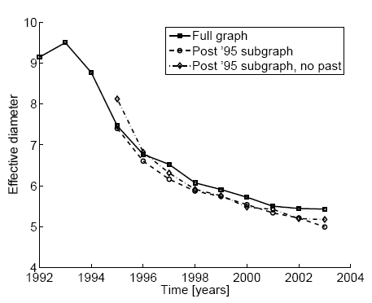
Diameter – ArXiv citation graph
Citations among physics papers
1992 –2003
One graph per year
diameter
time [years]

Slide 26
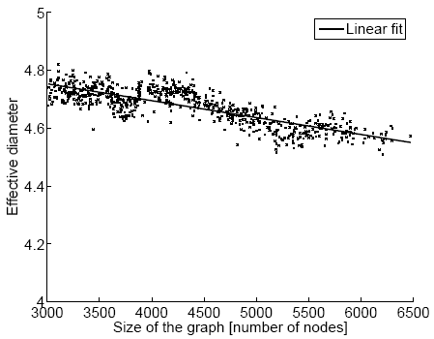
Diameter – “Autonomous Systems”
Graph of Internet
One graph per day
1997 – 2000
diameter
number of nodes

Slide 27
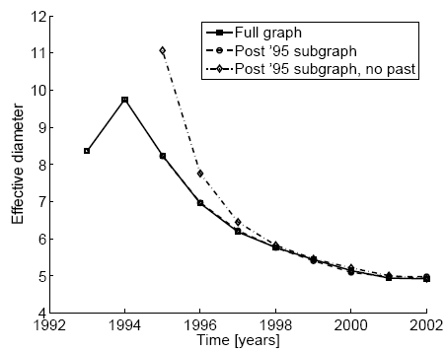
Diameter – “Affiliation Network”
Graph of collaborations in physics – authors linked to papers
10 years of data
diameter
time [years]

Slide 28
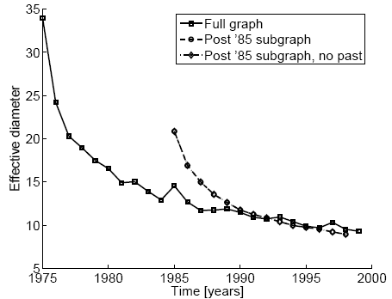
Diameter – “Patents”
diameter
Patent citation network
25 years of data
time [years]

Slide 29
Temporal Evolution of the Graphs
N(t) … nodes at time t
E(t) … edges at time t
Suppose that
  N(t+1) = 2 * N(t)
Q: what is your guess for
  E(t+1) =? 2 * E(t)

Slide 30
Temporal Evolution of the Graphs
N(t) … nodes at time t
E(t) … edges at time t
Suppose that
  N(t+1) = 2 * N(t)
Q: what is your guess for
  E(t+1) =? 2 * E(t)
A: over-doubled!
  But obeying the ``Densification Power Law’’

Slide 31
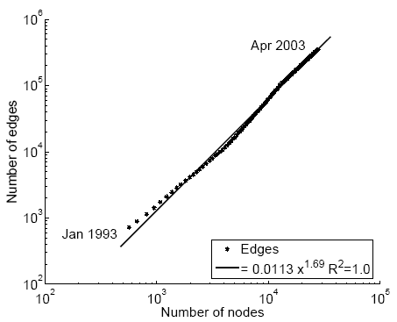
Densification – Physics Citations
Citations among physics papers
2003:
  29,555 papers, 352,807 citations
E(t)
??
N(t)

Slide 32
Densification – Physics Citations
Citations among physics papers
2003:
  29,555 papers, 352,807 citations
E(t)
1.69
N(t)

Slide 33
Densification – Physics Citations
Citations among physics papers
2003:
  29,555 papers, 352,807 citations
E(t)
1.69
1: tree
N(t)

Slide 34
Densification – Physics Citations
Citations among physics papers
2003:
  29,555 papers, 352,807 citations
E(t)
clique: 2
1.69
N(t)

Slide 35
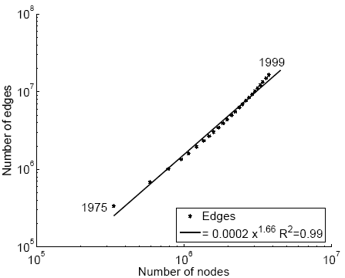
Densification – Patent Citations
Citations among patents granted
1999
  2.9 million nodes
  16.5 million edges
Each year is a datapoint
E(t)
1.66
N(t)

Slide 36
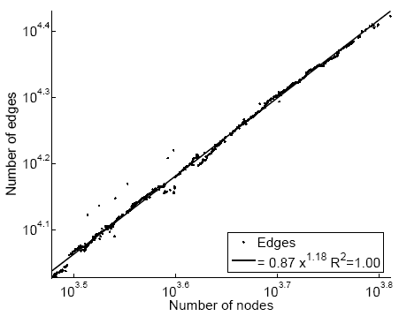
Densification – Autonomous Systems
Graph of Internet
2000
  6,000 nodes
  26,000 edges
One graph per day
E(t)
1.18
N(t)

Slide 37
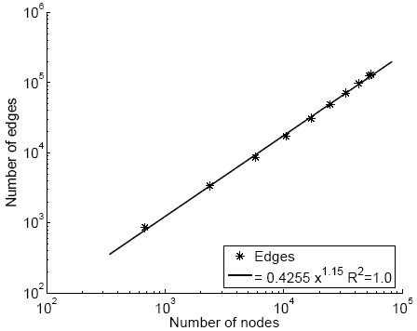
Densification – Affiliation Network
Authors linked to their publications
2002
  60,000 nodes
    20,000 authors
    38,000 papers
  133,000 edges
E(t)
1.15
N(t)

Slide 38
Motivation
Data mining: ~ find patterns (rules, outliers)
Problem#1: How do real graphs look like?
Problem#2: How do they evolve?
Problem#3: How to generate realistic graphs
TOOLS
Problem#4: Who is the ‘master-mind’?
Problem#5: Track communities over time

Slide 39
Problem#3: Generation
Given a growing graph with count of nodes N₁, N₂, …
Generate a realistic sequence of graphs that will obey all the patterns

Slide 40
Problem Definition
Given a growing graph with count of nodes N₁, N₂, …
Generate a realistic sequence of graphs that will obey all the patterns
  Static Patterns
    Power Law Degree Distribution
    Power Law eigenvalue and eigenvector distribution
    Small Diameter
  Dynamic Patterns
    Growth Power Law
    Shrinking/Stabilizing Diameters

Slide 41
Problem Definition
Given a growing graph with count of nodes N₁, N₂, …
Generate a realistic sequence of graphs that will obey all the patterns
Idea: Self-similarity
  Leads to power laws
  Communities within communities
  …

Slide 42
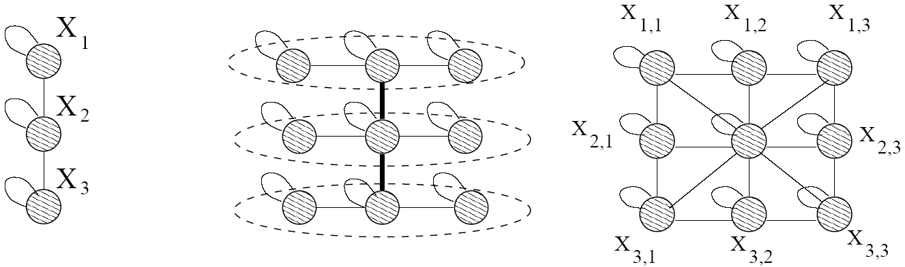
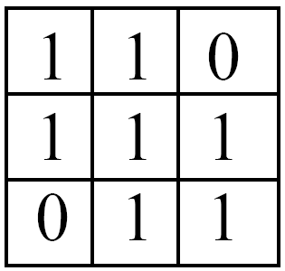
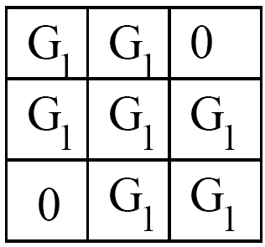


Kronecker Product – a Graph
Intermediate stage
Adjacency matrix
Adjacency matrix

Slide 43
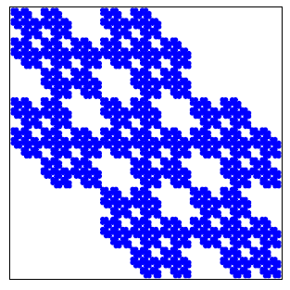
Kronecker Product – a Graph
Continuing multiplying with G₁ we obtain G₄ and so on …
G₄ adjacency matrix

Slide 44
Kronecker Product – a Graph
Continuing multiplying with G₁ we obtain G₄ and so on …
G₄ adjacency matrix

Slide 45
Kronecker Product – a Graph
Continuing multiplying with G₁ we obtain G₄ and so on …
G₄ adjacency matrix

Slide 46
Properties:
We can PROVE that
  Degree distribution is multinomial ~ power law
  Diameter: constant
  Eigenvalue distribution: multinomial
  First eigenvector: multinomial
See [Leskovec+, PKDD’05] for proofs

Slide 47
Problem Definition
Given a growing graph with nodes N₁, N₂, …
Generate a realistic sequence of graphs that will obey all the patterns
  Static Patterns
    Power Law Degree Distribution
    Power Law eigenvalue and eigenvector distribution
    Small Diameter
  Dynamic Patterns
    Growth Power Law
    Shrinking/Stabilizing Diameters
First and only generator for which we can prove all these properties
✓
✓
✓
✓
✓

Slide 48
Stochastic Kronecker Graphs
skip
Create N₁×N₁ probability matrix P₁
Compute the k^{th} Kronecker power P_{k}
For each entry p_{uv} of P_{k} include an edge (u,v) with probability p_{uv}
Kronecker
multiplication
0.16 | 0.08 | 0.08 | 0.04
0.04 | 0.12 | 0.02 | 0.06
0.04 | 0.02 | 0.12 | 0.06
0.01 | 0.03 | 0.03 | 0.09
0.4 | 0.2
0.1 | 0.3
Instance
Matrix G₂
P₁
flip biased
coins
P_{k}

Slide 49
Experiments
How well can we match real graphs?
  Arxiv: physics citations:
    30,000 papers, 350,000 citations
    10 years of data
  U.S. Patent citation network
    4 million patents, 16 million citations
    37 years of data
  Autonomous systems – graph of internet
    Single snapshot from January 2002
    6,400 nodes, 26,000 edges
We show both static and temporal patterns

Slide 50
(Q: how to fit the parm’s?)
A:
Stochastic version of Kronecker graphs +
Max likelihood +
Metropolis sampling
[Leskovec+, ICML’07]

Slide 51
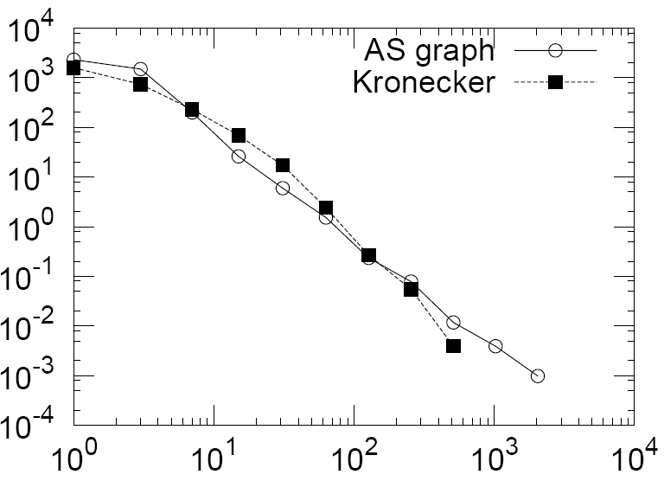
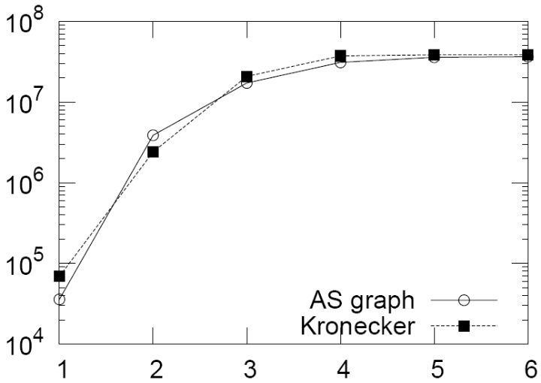
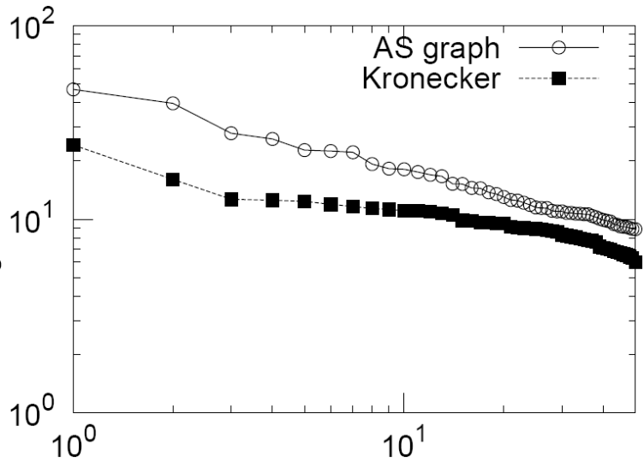
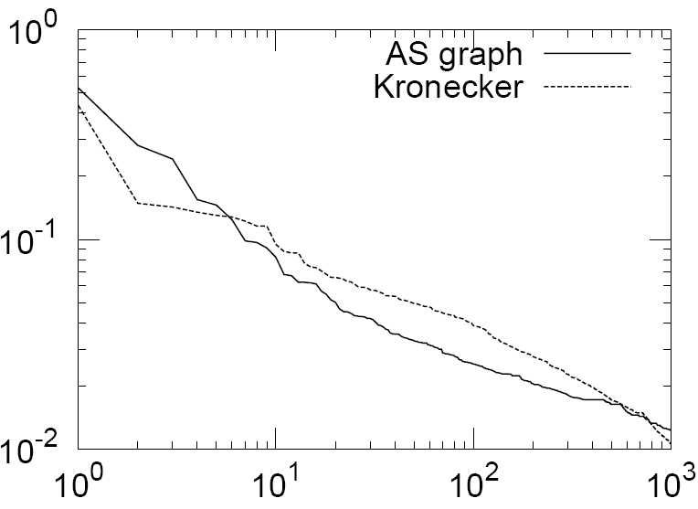
Experiments on real AS graph
Degree distribution
Hop plot
Adjacency matrix eigen values
Network value

Slide 52
Conclusions
Kronecker graphs have:
  All the static properties
    Heavy tailed degree distributions
    Small diameter
    Multinomial eigenvalues and eigenvectors
  All the temporal properties
    Densification Power Law
    Shrinking/Stabilizing Diameters
  We can formally prove these results
✓
✓
✓
✓
✓
Notes:
CHECKMARKS

Slide 53
Motivation
Data mining: ~ find patterns (rules, outliers)
Problem#1: How do real graphs look like?
Problem#2: How do they evolve?
Problem#3: How to generate realistic graphs
TOOLS
Problem#4: Who is the ‘master-mind’?
Problem#5: Track communities over time

Slide 54
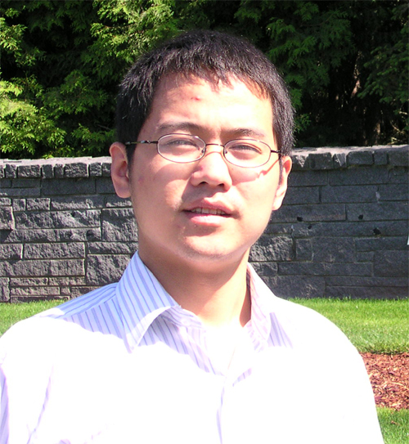
Problem#4: MasterMind – ‘CePS’
w/ Hanghang Tong, KDD 2006
htong <at> cs.cmu.edu

Slide 55
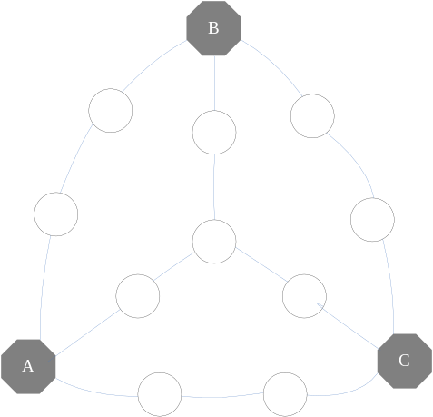

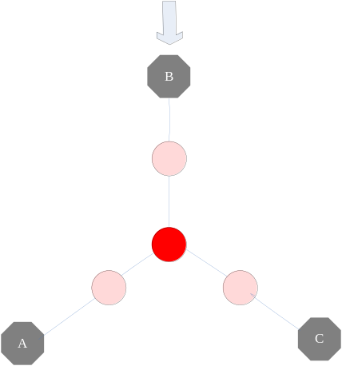
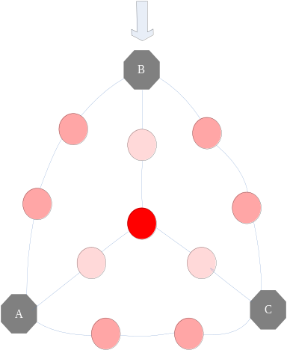
Center-Piece Subgraph(Ceps)
Given Q query nodes
Find Center-piece ( )
App.
  Social Networks
  Law Inforcement, …
Idea:
  Proximity -> random walk with restarts
Notes:
There are increasing interests in graph mining. In this talk, we introduce center-piece subgraphs. That is, given Q query nodes, we want to find nodes and the resulting subgraph, that have strong connection to all or most of the query nodes.
Our Ceps alg. takes three parameters as input: Q query nodes; the budget b, indicating how large the resulting subgraph is; and the k softand coefficient, which I will explain it later.
Here is an illustrating example, the upper figure is the original graph and given three query nodes (the red one), the importance of those intermediate nodes are indicated in the bottom figure.
Eh, throughout the talk, we use the color to indicate the importance of the nodes, more read means more important. And subsequently, its center-piece subgraph could be as follows.
In social network, say in a authorship network, we can use ceps to discover their common advisor, or an influential author in the field that Q query nodes belongs to. In law inforcement, the query nodes could be the suspects and by ceps, we can find the master-mind.

Slide 56

Case Study: AND query
R
.
Agrawal
Jiawei Han
V
.
Vapnik
M
.
Jordan
Notes:
Since christos is here, I will not make any comments on this face.

Slide 57
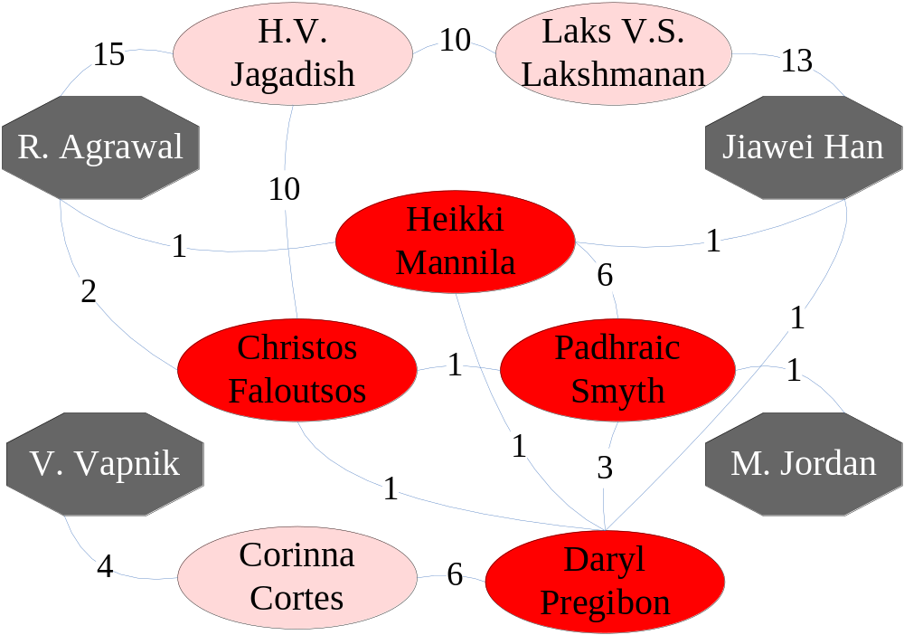
Case Study: AND query
Notes:
Since christos is here, I will not make any comments on this face.

Slide 58

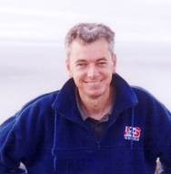

Case Study: AND query
Notes:
Since christos is here, I will not make any comments on this face.

Slide 59
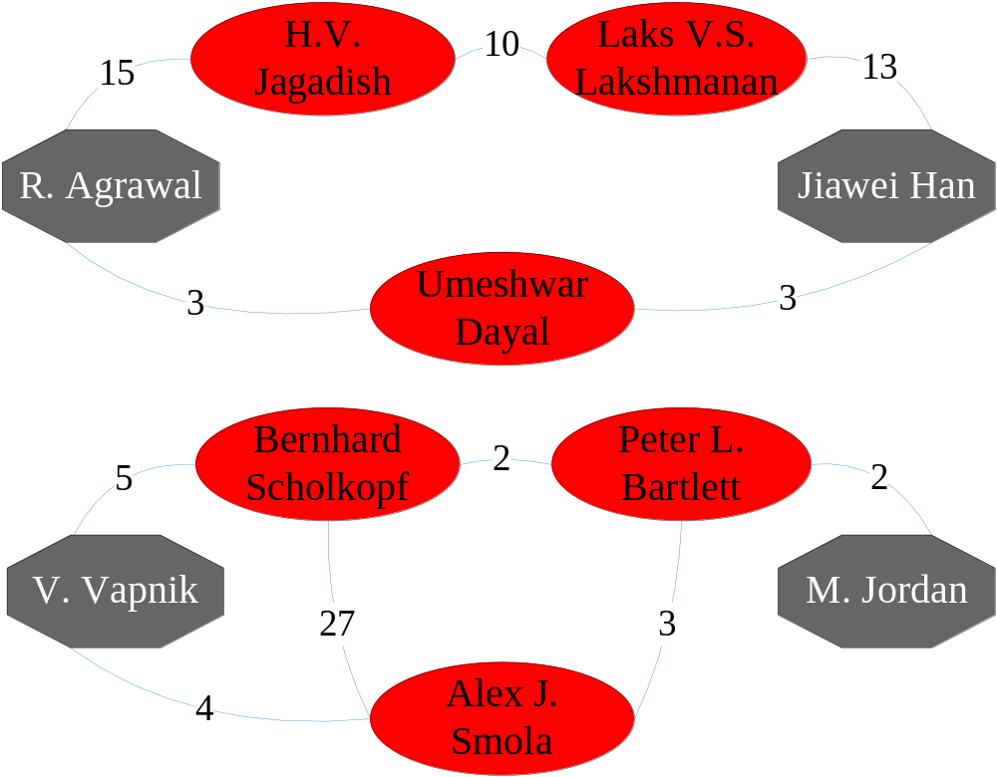
databases
ML/Statistics
2_SoftAnd query

Slide 60
Conclusions
Q1:How to measure the importance?
A1: RWR+K_SoftAnd
Q2:How to do it efficiently?
A2:Graph Partition (Fast CePS)
  ~90% quality
  150x speedup (ICDM’06, b.p. award)

Slide 61
Outline
Problem definition / Motivation
Static & dynamic laws; generators
Tools: CenterPiece graphs; Tensors
Other projects (Virus propagation, e-bay fraud detection)
Conclusions

Slide 62
Motivation
Data mining: ~ find patterns (rules, outliers)
Problem#1: How do real graphs look like?
Problem#2: How do they evolve?
Problem#3: How to generate realistic graphs
TOOLS
Problem#4: Who is the ‘master-mind’?
Problem#5: Track communities over time

Slide 63
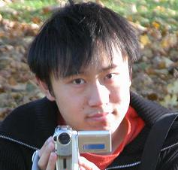

Tensors for time evolving graphs
[Jimeng Sun+ KDD’06]
[ “ , SDM’07]
[ CF, Kolda, Sun, SDM’07 tutorial]

Slide 64
Social network analysis
Static: find community structures
Keywords
1990
s
r
o
h
t
u
DB
A

Slide 65
Social network analysis
Static: find community structures
1992
1991
1990
s
r
o
h
t
u
DB
A

Slide 66
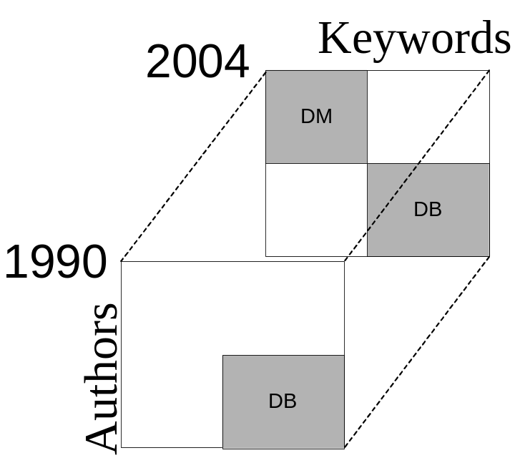
Social network analysis
Static: find community structures
Dynamic: monitor community structure evolution; spot abnormal individuals; abnormal time-stamps

Slide 67
Application 1: Multiway latent semantic indexing (LSI)
2004
Philip Yu
DM
Michael Stonebraker
1990
U_{authors}
DB
authors
U_{keyword}
DB
keyword
Pattern
Query
Projection matrices specify the clusters
Core tensors give cluster activation level

Slide 68
Bibliographic data (DBLP)
Papers from VLDB and KDD conferences
Construct 2nd order tensors with yearly windows with <author, keywords>
Each tensor: 4584×3741
11 timestamps (years)

Slide 69
Multiway LSI
Authors | Keywords | Year
michael carey, michael stonebraker, h. jagadish, hector garcia-molina | queri,parallel,optimization,concurr, objectorient | 1995
surajit chaudhuri,mitch cherniack,michael stonebraker,ugur etintemel | distribut,systems,view,storage,servic,process,cache | 2004
jiawei han,jian pei,philip s. yu, jianyong wang,charu c. aggarwal | streams,pattern,support, cluster, index,gener,queri | 2004
DB
DM
Two groups are correctly identified: Databases and Data mining
People and concepts are drifting over time

Slide 70
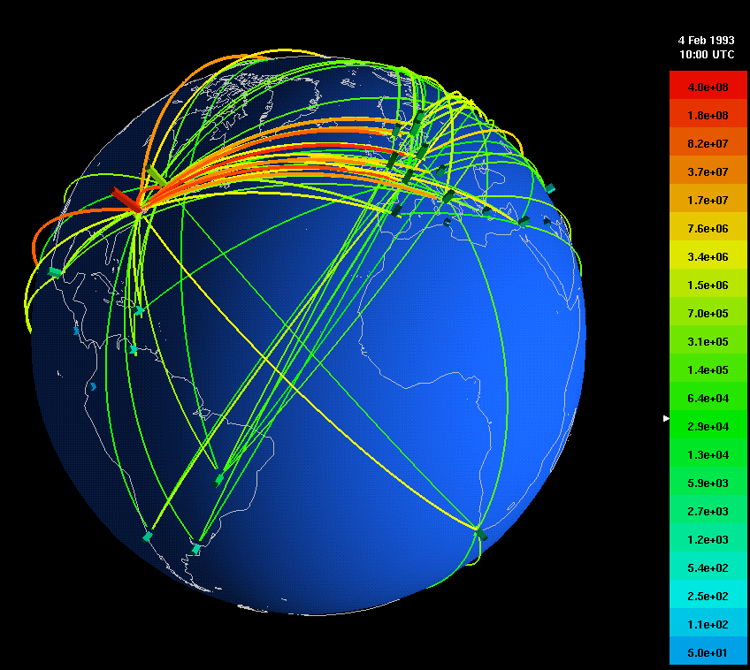
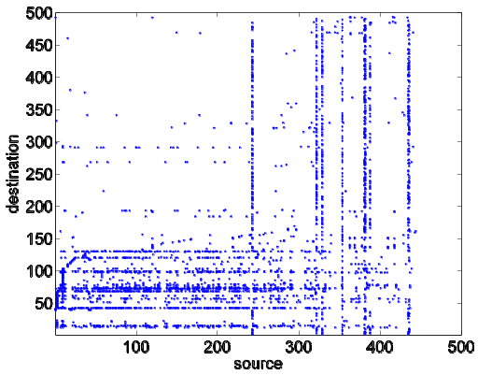
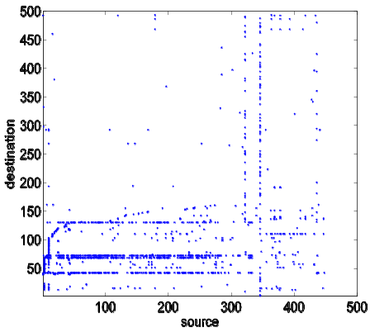
Network forensics
Directional network flows
A large ISP with 100 POPs, each POP 10Gbps link capacity [Hotnets2004]
  450 GB/hour with compression
Task: Identify abnormal traffic pattern and find out the cause
abnormal traffic
normal traffic
destination
destination
source
source
(with Prof. Hui Zhang and Dr. Yinglian Xie)

Slide 71
Conclusions
Tensor-based methods (WTA/DTA/STA):
spot patterns and anomalies on time evolving graphs, and
on streams (monitoring)

Slide 72
Motivation
Data mining: ~ find patterns (rules, outliers)
Problem#1: How do real graphs look like?
Problem#2: How do they evolve?
Problem#3: How to generate realistic graphs
TOOLS
Problem#4: Who is the ‘master-mind’?
Problem#5: Track communities over time

Slide 73
Outline
Problem definition / Motivation
Static & dynamic laws; generators
Tools: CenterPiece graphs; Tensors
Other projects (Virus propagation, e-bay fraud detection, blogs)
Conclusions

Slide 74
Virus propagation
How do viruses/rumors propagate?
Blog influence?
Will a flu-like virus linger, or will it become extinct soon?

Slide 75
The model: SIS
‘Flu’ like: Susceptible-Infected-Susceptible
Virus ‘strength’ s= β/δ
Healthy
Prob. δ
N2
Prob. β
N1
N
Prob. β
Infected
N3

Slide 76
Epidemic threshold τ
of a graph: the value of τ, such that
if strength s = β / δ < τ
an epidemic can not happen
Thus,
given a graph
compute its epidemic threshold

Slide 77
Epidemic threshold τ
What should τ depend on?
avg. degree? and/or highest degree?
and/or variance of degree?
and/or third moment of degree?
and/or diameter?

Slide 78
Epidemic threshold
[Theorem] We have no epidemic, if
β/δ <τ = 1/ λ_{1,A}

Slide 79
Epidemic threshold
[Theorem] We have no epidemic, if
epidemic threshold
recovery prob.
β/δ <τ = 1/ λ_{1,A}
attack prob.
largest eigenvalue
of adj. matrix A
Proof: [Wang+03]

Slide 80
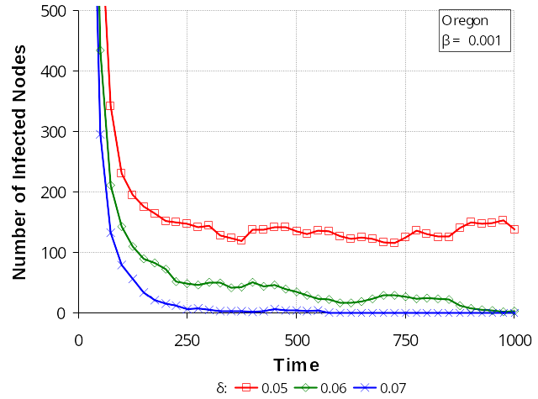
Experiments (Oregon)
β/δ > τ
(above threshold)
β/δ = τ
(at the threshold)
β/δ < τ
(below threshold)

Slide 81
Outline
Problem definition / Motivation
Static & dynamic laws; generators
Tools: CenterPiece graphs; Tensors
Other projects (Virus propagation, e-bay fraud detection, blogs)
Conclusions

Slide 82


E-bay Fraud detection
w/ Polo Chau &
Shashank Pandit, CMU

Slide 83
E-bay Fraud detection
lines: positive feedbacks
would you buy from him/her?

Slide 84
E-bay Fraud detection
lines: positive feedbacks
would you buy from him/her?
or him/her?

Slide 85
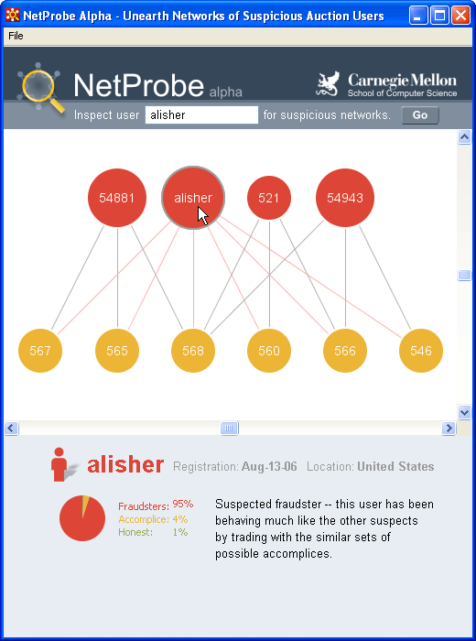
E-bay Fraud detection - NetProbe

Slide 86
Outline
Problem definition / Motivation
Static & dynamic laws; generators
Tools: CenterPiece graphs; Tensors
Other projects (Virus propagation, e-bay fraud detection, blogs)
Conclusions

Slide 87
Blog analysis
with Mary McGlohon (CMU)
Jure Leskovec (CMU)
Natalie Glance (now at Google)
Mat Hurst (now at MSR)
[SDM’07]

Slide 88
Cascades on the Blogosphere
B₁
1
a
B₂
B₁
1
B₂
b
c
1
2
d
B₃
1
B₃
B₄
3
e
B₄
Blogosphere
blogs + posts
Blog network
links among blogs
Post network
links among posts
Q1: popularity-decay of a post?
Q2: degree distributions?

Slide 89
Q1: popularity over time
# in links
1
2
3
days after post
Post popularity drops-off – exponentially?
Days after post

Slide 90
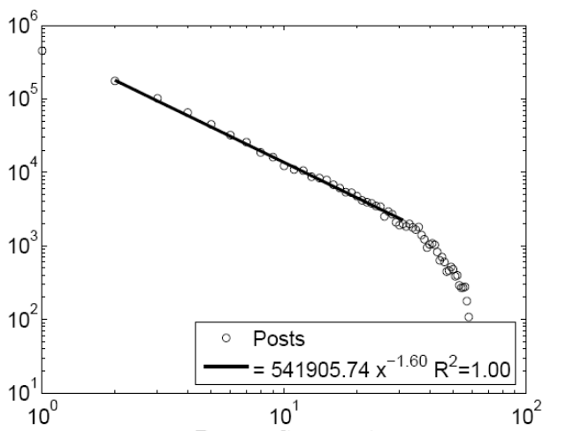
Q1: popularity over time
# in links
(log)
1
2
3
days after post
(log)
Post popularity drops-off – exponentially?
POWER LAW!
Exponent?
Days after post

Slide 91
Q1: popularity over time
# in links
(log)
-1.6
1
2
3
days after post
(log)
Post popularity drops-off – exponentially?
POWER LAW!
Exponent? -1.6 (close to -1.5: Barabasi’s stack model)
Days after post

Slide 92
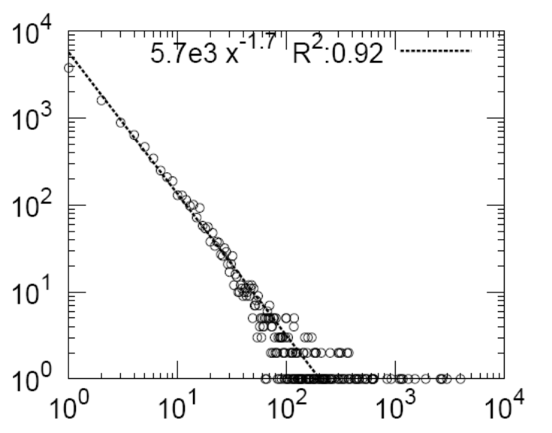
Q2: degree distribution
44,356 nodes, 122,153 edges. Half of blogs belong to largest connected component.
count
??
1
B₁
1
B₂
1
2
B₃
B₄
3
blog in-degree

Slide 93
Q2: degree distribution
44,356 nodes, 122,153 edges. Half of blogs belong to largest connected component.
count
1
B₁
1
B₂
1
2
B₃
B₄
3
blog in-degree

Slide 94
Q2: degree distribution
44,356 nodes, 122,153 edges. Half of blogs belong to largest connected component.
count
in-degree slope: -1.7
out-degree: -3
‘rich get richer’
blog in-degree

Slide 95
Next steps:
edges with categorical attributes and/or time-stamps
nodes with attributes
scalability (hadoop – PetaByte scale)
  first eigenvalue; diameter [done]
  rest eigenvalues; community detection [to be done]
  modularity, anomalies etc etc
visualization (-> summarization)

Slide 96
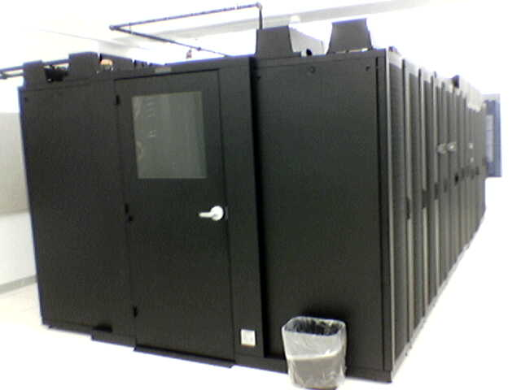
E.g.: self-* system @ CMU
>200 nodes
target: 1 PetaByte
Notes:
PT bytes, self-*, linux, gigabit link?

Slide 97

D.I.S.C.
‘Data Intensive Scientific Computing’ [R. Bryant, CMU]
  ‘big data’
  http://www.cs.cmu.edu/~bryant/pubdir/cmu-cs-07-128.pdf

Slide 98

Scalability
Google: > 450,000 processors in clusters of ~2000 processors each
Yahoo: 5Pb of data [Fayyad, KDD’07]
Problem: machine failures, on a daily basis
How to parallelize data mining tasks, then?
A: map/reduce – hadoop (open-source clone) http://hadoop.apache.org/
Barroso, Dean, Hölzle, “Web Search for a Planet: The Google Cluster Architecture” IEEE Micro 2003

Slide 99
2’ intro to hadoop
master-slave architecture; n-way replication (default n=3)
‘group by’ of SQL (in parallel, fault-tolerant way)
e.g, find histogram of word frequency
  slaves compute local histograms
  master merges into global histogram
select course-id, count(*)
from ENROLLMENT
group by course-id

Slide 100
2’ intro to hadoop
master-slave architecture; n-way replication (default n=3)
‘group by’ of SQL (in parallel, fault-tolerant way)
e.g, find histogram of word frequency
  slaves compute local histograms
  master merges into global histogram
select course-id, count(*)
from ENROLLMENT
group by course-id
reduce
map

Slide 101
OVERALL CONCLUSIONS
Graphs: Self-similarity and power laws work, when textbook methods fail!
New patterns (shrinking diameter!)
New generator: Kronecker
SVD / tensors / RWR: valuable tools
hadoop/mapReduce for scalability

Slide 102
References
Hanghang Tong, Christos Faloutsos, and Jia-Yu Pan Fast Random Walk with Restart and Its Applications ICDM 2006, Hong Kong.
Hanghang Tong, Christos Faloutsos Center-Piece Subgraphs: Problem Definition and Fast Solutions, KDD 2006, Philadelphia, PA

Slide 103
References
Jure Leskovec, Jon Kleinberg and Christos Faloutsos Graphs over Time: Densification Laws, Shrinking Diameters and Possible Explanations KDD 2005, Chicago, IL. ("Best Research Paper" award).
Jure Leskovec, Deepayan Chakrabarti, Jon Kleinberg, Christos Faloutsos Realistic, Mathematically Tractable Graph Generation and Evolution, Using Kronecker Multiplication
(ECML/PKDD 2005), Porto, Portugal, 2005.

Slide 104
References
Jure Leskovec and Christos Faloutsos, Scalable Modeling of Real Graphs using Kronecker Multiplication, ICML 2007, Corvallis, OR, USA
Shashank Pandit, Duen Horng (Polo) Chau, Samuel Wang and Christos Faloutsos NetProbe: A Fast and Scalable System for Fraud Detection in Online Auction Networks WWW 2007, Banff, Alberta, Canada, May 8-12, 2007.
Jimeng Sun, Dacheng Tao, Christos Faloutsos Beyond Streams and Graphs: Dynamic Tensor Analysis, KDD 2006, Philadelphia, PA

Slide 105
References
Jimeng Sun, Yinglian Xie, Hui Zhang, Christos Faloutsos. Less is More: Compact Matrix Decomposition for Large Sparse Graphs, SDM, Minneapolis, Minnesota, Apr 2007. [pdf]

Slide 106

THANK YOU!
Contact info:
www. cs.cmu.edu /~christos
(w/ papers, datasets, code, etc)

